Slide 1
DATA SCIENCE & ML CAPSTONE
2026
WILDFIRE EXPOSURE SCREENING
Wildfire Exposure
Screening
Purpose
Observed history
Landscape, terrain and climate
Comparative 2026 estimate
A reproducible GIS and machine-learning workflow for broad-area location research.
Narrow broad search areas
Serhii Diadechko
Then continue with local evidence
Serhii Diadechko | Data Science & Machine Learning Capstone
Notes:
Open with the decision problem. A person may need to compare broad parts of mainland Portugal before spending time on municipal, site and property-specific checks. The project offers comparative evidence, not a property recommendation.
[Sources]
Project README; docs/project_brief.md

Slide 2
DATASET OVERVIEW
2 / 8
One 1 km mainland cell per year makes the evidence comparable
OBSERVED FIRE
PLACE CONTEXT
CLIMATE CONTEXT
ICNF annual burned areas
CLC and Copernicus DEM
ERA5-Land JJAS
Historical occurrence and next-year burned-share outcomes. Fire recurrence is measured in a 2 km context buffer.
Built-up share, forest/shrub context and mean slope describe the surrounding landscape.
Warm-season temperature, precipitation and shallow soil-water conditions from predictor year T only.
2000–2025 coverage
→
Static or governed historical layers
→
0.1° regional climate cells
Use: observed history and outcome labels
Use: landscape and terrain predictors
Use: predictor-year climate context
Burned share = burned land area / cell land area.
No parcel-level claim.
No interpolation or downscaling.
89,112 mainland cells; one EPSG:3763 1 km cell × predictor year record.
Serhii Diadechko | Data Science & Machine Learning Capstone
Notes:
Describe what one row represents: a mainland Portugal 1 km cell in a predictor year. Explain the three source roles. The 2 km buffer is a context measurement, not a second grid.
[Sources]
docs/data_dictionary.md; reports/validation/canonical_full_scope_readiness.md

Slide 3
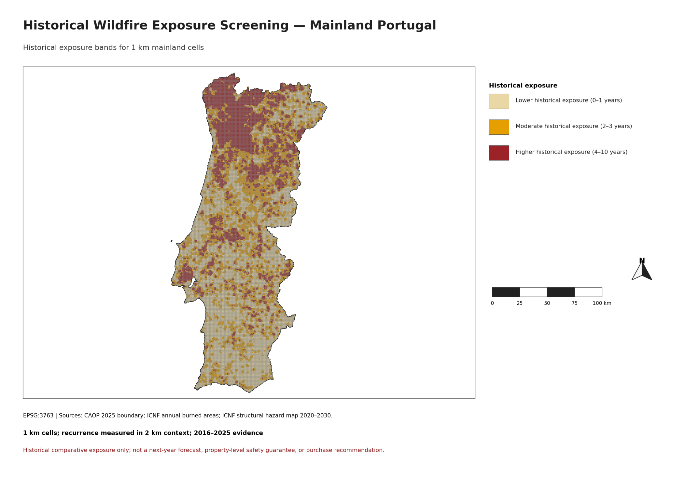
KEY FINDING 1
3 / 8
Historical wildfire recurrence is uneven across mainland Portugal
01
Reading the slides out loud
Fix: Your slides show the chart. You explain what it means. Script: "This chart shows X — what's interesting is Y, because Z."
02
Too many charts, not enough story
Fix: Max 1 chart per slide. Ask: does removing this chart break the argument? If not, cut it.
03
Data without context
Fix: Always say what the number means relative to something. "€1,847 average" means nothing. "€1,847 — 3x higher than online courses" means something.
04
Weak conclusions
Fix: Ban "in conclusion, more research may be needed." Replace with: "We recommend X. The data supports this because Y."
05
Going over time
Serhii Diadechko | Data Science & Machine Learning Capstone
Fix: Practice out loud with a timer. 8 slides x 1.5 min = 12 min. That's your target.
Notes:
This is observed historical evidence, not a prediction. The bands count distinct burned years from 2016 to 2025 in the mainland-masked 2 km context around each 1 km cell. Lower historical exposure does not mean safe.
[Sources]
reports/figures/historical_wildfire_exposure_screening_mainland_portugal.png; reports/validation/historical_exposure_screening_and_icnf_comparison.md

Slide 4
KEY FINDING 2
4 / 8
Historical recurrence and structural hazard provide complementary context
Evidence layers
One comparison, two sources
v
Counts 2016–2025 burned years in the 2 km context around each 1 km cell.
Technical
v
Use the layers together to understand patterns; neither layer is a buyer threshold.
v
Official structural hazard
v
Maps describe evidence; they do not certify a location.
v
An official ICNF classification of underlying landscape hazard conditions, summarised from 25 m classes to the predominant 1 km class.
v
Both layers still require local verification.
v
Why compare both?
Delivery Tips
v
They use different methods and time frames, so agreement or disagreement adds context.
Takeaway
Observed recurrence = what burned.
v
Interpretation
Structural hazard = underlying landscape classification.
Structural hazard is not this project’s prediction and does not describe one particular year’s burned area.
Together = broader screening context.
v
No model-accuracy claim is made from this comparison.
The official ICNF layer is a reference, not the project’s ML output.
Serhii Diadechko | Data Science & Machine Learning Capstone
Notes:
Explain the distinction carefully. Historical recurrence records how often cells burned in the 2016–2025 evidence window, using a 2 km context. Structural hazard is an official ICNF classification of persistent landscape hazard conditions, aggregated from 25 m classes to the predominant 1 km class. The comparison is descriptive context, not a model accuracy test.
[Sources]
qgis/README.md; docs/data_dictionary.md; reports/figures/historical_exposure_by_icnf_structural_hazard_crosstab.png

Slide 5
KEY FINDING 3 — MODEL
5 / 8
The nine-feature model improves selected comparative diagnostics
MODEL COMPARISON
HOW TO READ IT
v
Baseline → nine-feature model
Technical
v
MAE is average error in burned-share units; lower is better.
v
Historical recurrence baseline
v
RMSE gives more weight to larger errors; lower is better.
v
Nine-feature hurdle model
v
Capture@20% is the share of observed burned share found among the 20% highest-scored cells.
v
MAE: 0.029 → 0.021
Delivery Tips
v
RMSE: 0.111 → 0.111
It is a ranking diagnostic, not a buyer threshold.
The model improves selected comparisons, but extreme fire years remain difficult.
v
Capture@20%: 0.482 → 0.500
The target is continuous burned share: burned land area divided by cell land area.
Final temporal test: T=2022–2024; outcomes in T+1.
The nine-feature model uses a two-part regression for the zero-heavy target.
v
No final-test result is used to claim a property-level forecast.
Conclusion: useful comparative improvement with visible uncertainty.
Serhii Diadechko | Data Science & Machine Learning Capstone
Notes:
Introduce the transparent historical recurrence baseline and the nine-feature hurdle model. The baseline maps prior recurrence to expected next-year burned share. The hurdle model uses a first component for whether burning occurs and a second component for positive burned share. The table reports the frozen final temporal comparison. Capture@20% asks how much observed burned share lies among the 20% highest-ranked cells; it is only a technical ranking diagnostic.
[Sources]
reports/validation/model_final_decision.md; reports/figures/model_final_test_metric_comparison.png

Slide 6
RECOMMENDED USE CASE
6 / 8
A prospective buyer narrows a national location search
START WITH
SHORTLIST AREAS
USE CASE OUTCOME
2026 comparative estimate
Focus the search
A smaller search area
Rank broad 1 km areas using 2025 predictor inputs.
Prioritise broad areas for visits and deeper research.
The QGIS layers help decide where to investigate first.
COMPARE CONTEXT
→
LOCAL VERIFICATION
→
NOT A FINAL DECISION
Historical recurrence + official ICNF structural hazard
Check local evidence
Continue locally
Read the three layers side by side before shortlisting areas.
Review planning, access, insurance, terrain and site conditions.
The 1 km estimate cannot replace property-specific checks.
The model guides the research order; local evidence supports the final choice.
Serhii Diadechko | Data Science & Machine Learning Capstone
Notes:
Use a simple scenario: a prospective buyer is considering several broad areas in mainland Portugal. Start with the 2026 comparative estimate, which ranks 1 km cells using 2025 predictor inputs. Then read the historical recurrence and official ICNF structural-hazard layers alongside it; these are separate evidence layers, not one combined score. The practical output is a shorter list of broad areas to visit and investigate first. Local planning, access, insurance, terrain and property-specific evidence still complete the decision.
[Sources]
qgis/wildfire_exposure_screening_portugal_2026.qgz; qgis/README.md; reports/validation/operational_forecast_2026_validation.md

Slide 7
RESPONSIBLE DECISION PATH
7 / 8
Use three evidence layers together, then verify locally
Recommended actions
Why this matters
v
Use the 2026 comparative estimate to narrow broad-area research.
Technical
v
The project gives a reproducible first screen. A real property decision needs evidence that a national 1 km model cannot provide.
v
Check 2016–2025 observed recurrence in the 2 km context.
v
The workflow is designed to make uncertainty visible rather than hide it.
v
Compare the separate official ICNF structural-hazard class.
v
The annual update process keeps the evidence current without changing the project’s scientific contract.
v
Investigate municipal plans, access, vegetation, insurance and site conditions.
Delivery Tips
v
Rebuild annually when new labelled outcomes and completed-year inputs are available.
Talk track
Start broad.
v
Keep source files, model version and forecast year traceable.
Compare layers.
Keep local verification in the workflow.
Verify locally.
v
Use evidence before deciding.
The practical question is: which areas deserve deeper investigation first?
Serhii Diadechko | Data Science & Machine Learning Capstone
Notes:
The project narrows the broad search area, then hands the decision to local investigation. Read the three layers together, keep their source roles distinct, and retain traceability when the annual update is run.
[Sources]
README.md; docs/operational_forecast_cycle.md

Slide 8
CONCLUSION
8 / 8
The workflow narrows the search area and keeps evidence traceable
DELIVERED
MODEL RESULT
NEXT STEPS FOR THIS PROJECT
Reproducible national workflow
Hypothesis partially supported
Refresh, rebuild, validate
Validated source checks, one consistent 1 km grid, QGIS layers, and an annual update path.
The nine-feature model improves selected comparative diagnostics, but does not solve extreme-event underprediction.
1. Add the latest completed-year sources. 2. Rebuild the target-free estimate and QGIS layer. 3. When outcomes arrive, evaluate the estimate. 4. Repeat annually.
Historical evidence + GIS context
→
2026 is target-free
→
HOW TO USE THE OUTPUTS
A separate 2016–2025 recurrence screen and official ICNF structural-hazard comparison.
Its future performance must be evaluated only after observed outcome data are available.
Use the maps to narrow broad areas, then check local site, planning, insurance and property evidence.
Transparent source roles and limitations.
No retrospective claim about unknown outcomes.
The outputs support screening; the next decision still requires local evidence.
Next milestone: refresh with new data and evaluate when the observed outcome arrives.
Serhii Diadechko | Data Science & Machine Learning Capstone
Notes:
Close with the repeatable project cycle: refresh completed-year inputs, rebuild the target-free estimate, use the maps to narrow broad areas, and evaluate the estimate when the observed outcome becomes available. The project’s practical result is a focused search area and a traceable evidence workflow.
[Sources]
README.md; reports/validation/model_final_decision.md; reports/validation/operational_forecast_readiness.md

